Slide 1
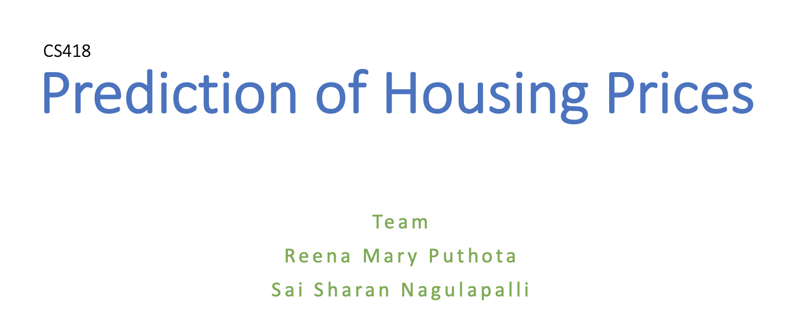

Slide 2
Problem Statement
Ask a home buyer to describe their dream house and they probably won't begin with the height of the basement ceiling or the proximity to an east-west railroad. This dataset proves that much more influences price negotiations than the number of bedrooms or a white-picket fence
It also predicts the category of the price - high, medium high, medium low, low

Slide 3
Data Description
House Pricing - Kaggle
The dataset consists of 76 features representing all possible factors that influence the decision making while purchasing a house.
Some of the features are : GarrageSF, GarrageQuality, GarrageArea, OverallQuality, FirePlace, PoolArea, Fence, 1stFlrSF, GarrageSF, GrLivArea, TotalBsmtSF etc
Most of the data is categorical and numerical that can be easily transformed to numerical data for data science purposes

Slide 4
Data Cleaning
For categorical columns, original Data Description had predefined labels of NA and None
Ex: GarageType: Garage location { Attchd, Basment, NA}
For such data-> We filled missing data with NA/None accordingly
For numerical columns, which didn’t have predefined classes, we filled missing data with modes of the data
Clean data otherwise

Slide 5
Data Science Solution
Regression:
Simple Linear Multiple Linear
Classification:
Decision Tree K-Nearest Neighbour Naive Bayes: Gaussian, Multinomal SVM: Linear, Kernel

Slide 6
Results: Regression
 | Simple Linear Regression | Multiple Linear Regression
R square | 0.6249 | 0.7497
Adjusted R square | - | 0.56099

Slide 7
Results: Classification
 | Accuracy | Error
Decision Tree | 0.801 | 0.198
KNN | 0.760 | 0.240
Gaussian NB | 0.726 | 0.274
Bernoulli NB | 0.616 | 0.383
Linear SVM | 0.767 | 0.232
Kernel SVM | 0.760 | 0.240

Slide 8
THANK YOU

